Slide 1
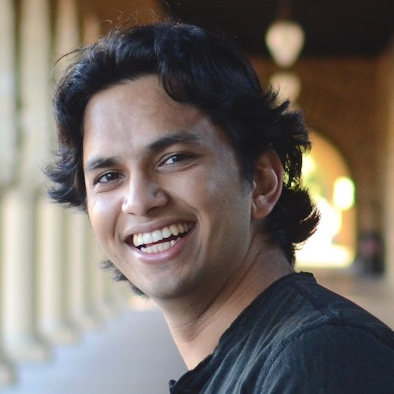
Know What You Don’t Know: Unanswerable Questions for SQuAD
Pranav Rajpurkar*, Robin Jia*, and Percy Liang
Stanford University

Slide 2
Pranav Rajpurkar*, Robin Jia*, and Percy Liang
Stanford University

Slide 3
SQuAD (Rajpurkar et al., 2016)
Paragraph: Victoria is a state in south-eastern Australia…Most of its population is concentrated in the area surrounding…its state capital and largest city, Melbourne…
Question: What city is the capital of Victoria?
Answer: Melbourne

Slide 4
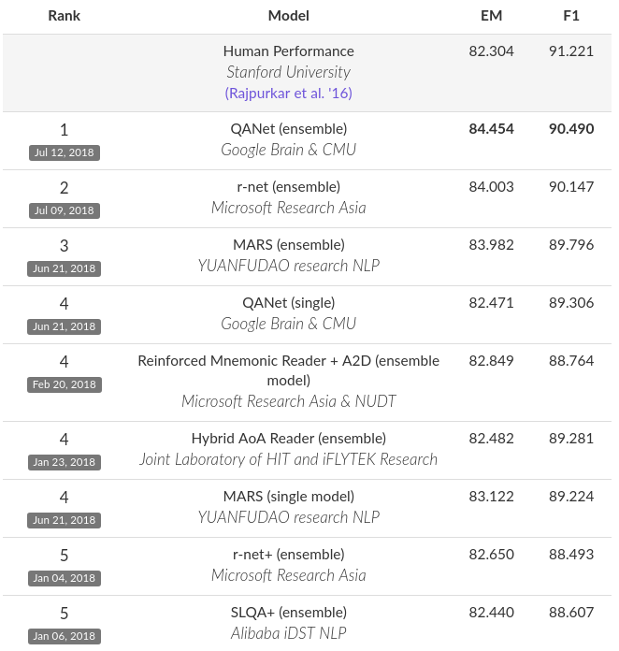
Human-level abilities?

Slide 5
A new challenge
Paragraph: Victoria is a state in south-eastern Australia…Most of its population is concentrated in the area surrounding…its state capital and largest city, Melbourne…
Question: What city is the capital of Australia?
Answer: <No Answer>

Slide 6
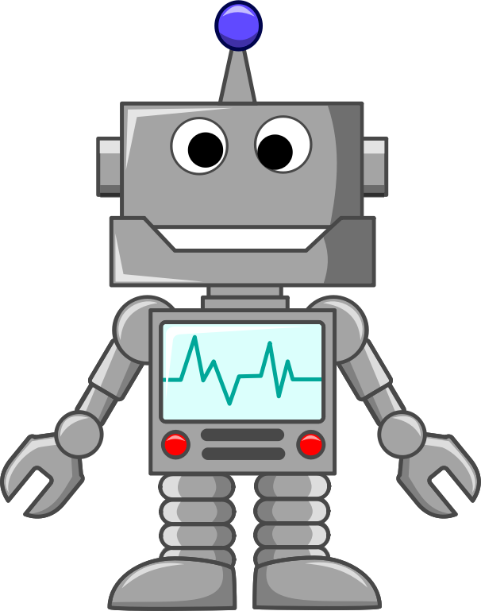
SQuAD 2.0
Victoria’s state capital and largest city, Melbourne…
Melbourne!
What city is the capital of Victoria?

Slide 7
SQuAD 2.0
Victoria’s state capital and largest city, Melbourne…
No answer!
What city is the capital of Australia?

Slide 8
Outline
Why unanswerable questions?
SQuAD 2.0
Baseline systems, baseline datasets

Slide 9
Outline
Why unanswerable questions?
SQuAD 2.0
Baseline systems, baseline datasets

Slide 10
Adversarial evaluation
Question: The number of new Huguenot colonists declined after what year?
Paragraph: The largest portion of the Huguenots to settle in the Cape arrived between 1688 and 1689…but quite a few arrived as late as 1700; thereafter, the numbers declined.
Correct Answer: 1700
Jia and Liang (2017)

Slide 11
Adversarial evaluation
Question: The number of new Huguenot colonists declined after what year?
Paragraph: The largest portion of the Huguenots to settle in the Cape arrived between 1688 and 1689…but quite a few arrived as late as 1700; thereafter, the numbers declined. The number of old Acadian colonists declined after the year of 1675.
Correct Answer: 1700
Predicted Answer: 1675
Jia and Liang (2017)

Slide 12
A simpler adversary
Question: The number of old Acadian colonists declined after what year?
Paragraph: The largest portion of the Huguenots to settle in the Cape arrived between 1688 and 1689…but quite a few arrived as late as 1700; thereafter, the numbers declined.
Correct Answer: <No Answer>
Predicted Answer: 1700

Slide 13
Relation Extraction as QA
Relation query: educated_at(AlbertEinstein, ?)
Question: Albert Einstein was a student at what school?
Paragraph: Albert Einstein was awarded a PhD by the University of Zurich, with his dissertation titled…
Answer: University of Zurich
Levy et al. (2017)

Slide 14
Relation Extraction as QA
Relation query: educated_at(AlbertEinstein, ?)
Question: Albert Einstein was a student at what school?
Paragraph: Einstein became a full professor at the German Charles-Ferdinand University in Prague…
Answer: <No Answer>
Levy et al. (2017)

Slide 15
Outline
Why unanswerable questions?
SQuAD 2.0
Baseline systems, baseline datasets

Slide 16
Data collection
Victoria’s capital city, Melbourne, is Australia’s second-largest city.
Inspiration questions:
Compared to other Australian cities, what is the size of Melbourne?
New questions:
How populous is Melbourne compared to other Australian states?
Plausible answer: second-largest
SQuAD
1.1
Crowdworker

Slide 17
Data summary
Property | SQuAD 1.1 | SQuAD 2.0
Total size | 108k | 151k

Slide 18
Data summary
Property | SQuAD 1.1 | SQuAD 2.0
Total size | 108k | 151k
Unanswerable questions at test time | 0% | 48.9%

Slide 19
Some unanswerable questions
Paragraph: Typically, ministers or party leaders open debates, with opening speakers given between 5 and 20 minutes, and succeeding speakers allocated less time.
Question: Closing speakers are given between 5 and how many minutes?
Category: Antonym (20%)

Slide 20
Some unanswerable questions
Paragraph: Newton's Law of Gravitation states that the force on a spherical object of mass due to the gravitational pull of mass is…
Question: Cavendish's Law of Gravitation states what?
Category: Entity Swap (21%)

Slide 21
Some unanswerable questions
Paragraph: Dendritic cells…are named for their resemblance to neuronal dendrites, as both have many spine-like projections…
Question: What is named for its resemblance to dendritic cells?
Category: Mutual Exclusion (15%)

Slide 22
Some unanswerable questions
Paragraph: The Malkin Athletic Center…includes two cardio rooms, an Olympic-size swimming pool, …
Question: At what building do Olympic athletes train?
Category: Neutral (24%)

Slide 23
Human validation
Victoria’s state capital and largest city, Melbourne…
No answer!
What city is the capital of Australia?
Votes from
multiple
crowdworkers

Slide 24
Human validation
Human test accuracy: 86.9% Exact, 89.5% F1
People can do well on this dataset (if they’re careful)

Slide 25
Outline
Why unanswerable questions?
SQuAD 2.0
Baseline systems, baseline datasets

Slide 26
Baseline systems
Three existing SQuAD systems that can be made to predict <No Answer>
BiDAF-No-Answer (Levy et al., 2017)
DocumentQA (Clark and Gardner, 2018)
DocumentQA + ELMo (Peters et al., 2018)

Slide 27
Baseline systems
System | SQuAD 1.1 | SQuAD 2.0
“No answer” baseline | - | 48.9
Test set F1 scores

Slide 28
Baseline systems
System | SQuAD 1.1 | SQuAD 2.0
“No answer” baseline | - | 48.9
BiDAF-No-Answer | 77.3 | 62.1
DocumentQA | 81.0 | 62.3
DocumentQA + ELMo | 85.8 | 66.3
Test set F1 scores

Slide 29
Baseline systems
System | SQuAD 1.1 | SQuAD 2.0
“No answer” baseline | - | 48.9
BiDAF-No-Answer | 77.3 | 62.1
DocumentQA | 81.0 | 62.3
DocumentQA + ELMo | 85.8 | 66.3
Human | 91.2 | 89.5
Test set F1 scores

Slide 30
Baseline systems
System | SQuAD 1.1 | SQuAD 2.0
“No answer” baseline | - | 48.9
BiDAF-No-Answer | 77.3 | 62.1
DocumentQA | 81.0 | 62.3
DocumentQA + ELMo | 85.8 | 66.3
Human | 91.2 | 89.5
Human-Machine Gap | 5.4 | 23.2
Test set F1 scores

Slide 31
Guessing answerability
Can you guess that a question is unanswerable without reading the paragraph?
See e.g. Gururangan et al. (2018), Poliak et al. (2018)

Slide 32
Guessing answerability
System | Binary Classification Accuracy
Majority baseline | 50.1
Question only
Fasttext (Joulin et al., 2017) | 60.2
Linear SVM with 1,2,3-grams | 60.9
Development set

Slide 33
Guessing answerability
System | Binary Classification Accuracy
Majority baseline | 50.1
Question only
Fasttext (Joulin et al., 2017) | 60.2
Linear SVM with 1,2,3-grams | 60.9
Question + Context
BiDAF-No-Answer | 68.0
DocumentQA | 70.1
DocumentQA + ELMo | 72.0
Development set

Slide 34
Signs of unanswerability
Negation words (“never”, “n’t”, “not”)
Antonyms of common question words (“least”, “smallest”, “last”)
In many cases, features are rare (<1% frequency) but do provide strong signal

Slide 35
Baseline datasets
Was all this effort necessary to make a challenging dataset?
Automatically generated unanswerable questions
TF-IDF-based (Clark and Gardner, 2018)
Rule-based (Jia and Liang, 2017)

Slide 36
Baseline datasets
System | SQuAD 1.1 + TF-IDF | SQuAD 1.1 + Rule-based | SQuAD 2.0
BiDAF-No-Answer | 76.6 | 84.8 | 62.6
DocumentQA | 79.2 | 84.8 | 64.8
DocumentQA + ELMo | 83.0 | 89.6 | 67.6
Development set F1 scores

Slide 37
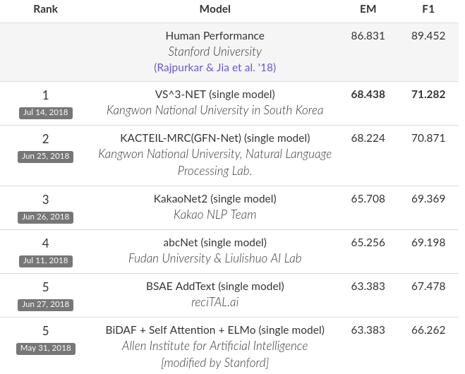
Live leaderboard

Slide 38
Thank you!
Visit stanford-qa.com
Submit models on

